Slide 1
Android
Application Development
A Tutorial Driven Course

Slide 2
Java
Basic Java programming
Exceptions
Inner Class, Interface
Advanced topics we will touch:
Java IO
Java Thread
Java Socket

Slide 3
Android Basics
Credit goes to Google!

Slide 4
Course Objectives
Mobile Application Development (MAD)
Intro to Android platform
Platform architecture
Application building blocks
Development tools
Textbook: Hello, Android

Slide 5
Few reasons to go MAD…
Smart Phones
Internet access anywhere
Social networking
Millions of mobile users
Open standards

Slide 6
Introduction to Android
Open software platform for mobile development
A complete stack – OS, Middleware, Applications
An Open Handset Alliance (OHA) project
Powered by Linux operating system
Fast application development in Java
Open source under the Apache 2 license

Slide 7
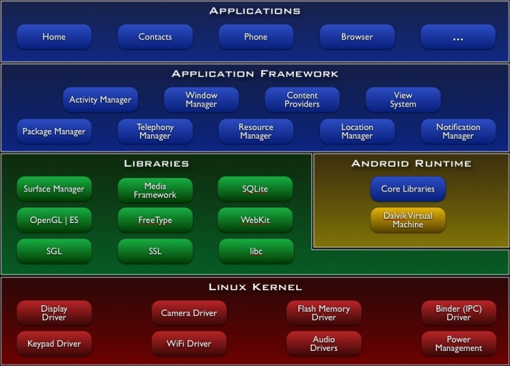

Slide 8
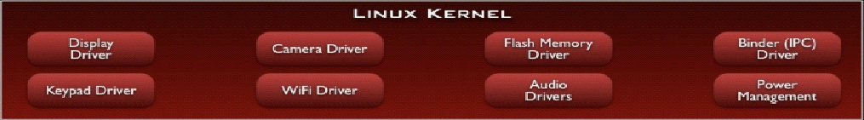
Linux Kernel
Works as a HAL
Device drivers
Memory management
Process management
Networking

Slide 9
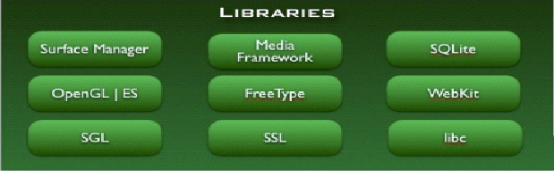
Libraries
C/C++ libraries
Interface through Java
Surface manager – Handling UI Windows
2D and 3D graphics
Media codecs, SQLite, Browser engine

Slide 10
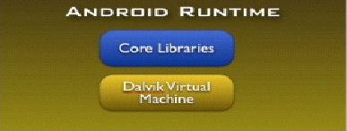
Android Runtime
Dalvik VM
Dex files
Compact and efficient than class files
Limited memory and battery power
Core Libraries
Java 5 Std edition
Collections, I/O etc…

Slide 11
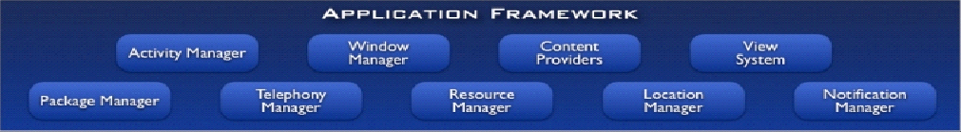
Application Framework
API interface
Activity manager – manages application life cycle.

Slide 12
Applications
Built in and user apps
Can replace built in apps

Slide 13
Course Objectives
Mobile Application Development (MAD)
Intro to Android platform
Platform architecture
Application building blocks
Development tools
Textbook: Hello, Android

Slide 14
Application Building Blocks
Activity
IntentReceiver
Service
ContentProvider

Slide 15
Activities
Typically correspond to one UI screen
But, they can:
Be faceless
Be in a floating window
Return a value

Slide 16
IntentReceivers
Components that respond to broadcast ‘Intents’
Way to respond to external notification or alarms
Apps can invent and broadcast their own Intent

Slide 17
Intents
Think of Intents as a verb and object; a description of what you want done
E.g. VIEW, CALL, PLAY etc..
System matches Intent with Activity that can best provide the service
Activities and IntentReceivers describe what Intents they can service

Slide 18









Intents
Home
System picks best component for that action
Photo Gallery
Contacts
“Pick photo”
GMail
Client component makes a request for a specific action
Chat
Blogger
Blogger
New components can use existing functionality

Slide 19
Services
Faceless components that run in the background
E.g. music player, network download etc…

Slide 20
ContentProviders
Enables sharing of data across applications
E.g. address book, photo gallery
Provides uniform APIs for:
querying
delete, update and insert.
Content is represented by URI and MIME type

Slide 21
Course Objectives
Mobile Application Development (MAD)
Intro to Android platform
Platform architecture
Application building blocks
Development tools
Textbook: Hello, Android

Slide 22
Development Tools
Eclipse
Android SDK 2.0 or higher
developer.android.com

Slide 23
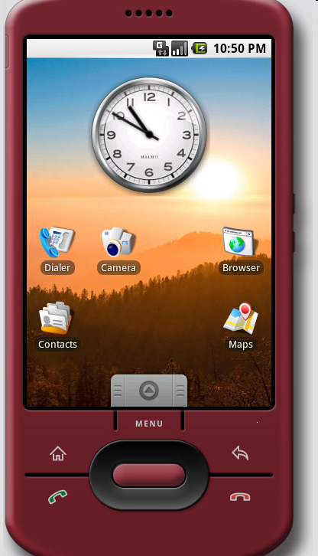
The Emulator
QEMU-based ARM emulator
Runs the same image as the device
Limitations:
No Camera support

Slide 24
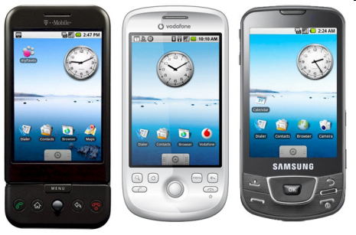
Devices

Slide 25
Hello World
A great starting point: http://developer.android.com/guide/tutorials/hello-world.html
Generating UIs
Views – building blocks
E.g. TextView, EditText, Button
Placed into Layouts
E.g. LinearLayout, TableLayout, AbsoluteLayout

Slide 26
Application Lifecycle
Application run in their own processes (VM, PID)
Processes are started and stopped as needed to run an application's components
Processes may be killed to reclaim resources

Slide 27
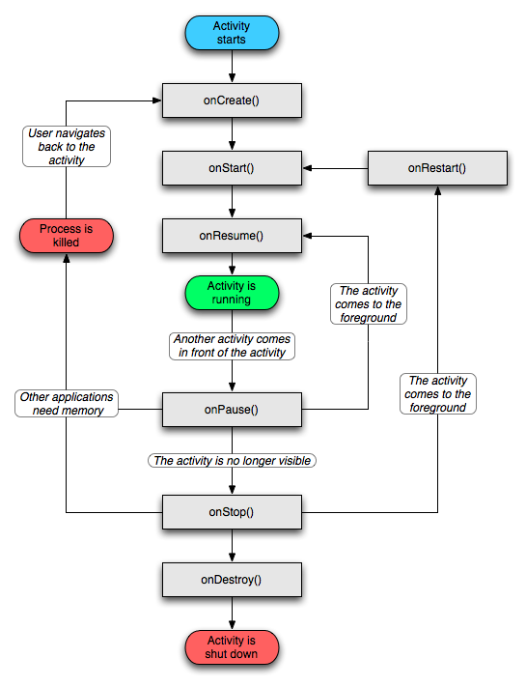

Slide 28
Lifecycle
System Process
Home
Mail
Browser
Home
Map
Contacts
GMail

Slide 29
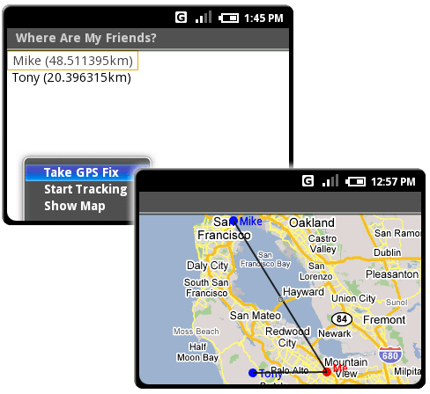
Location Manager

Slide 30
XMPP Services
Allows any app to send device-to-device messages to other android users
Data Messages are Intents with name/value pairs
Works with any gmail account…
Can also build servers to deliver server-to-device messages

Slide 31
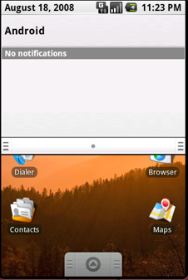
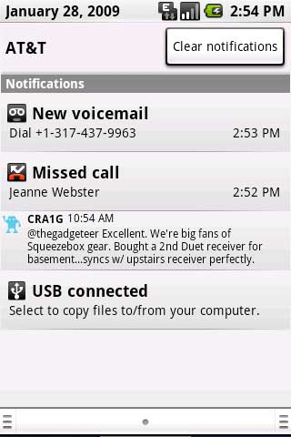
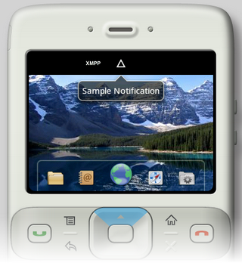
Notification Manager

Slide 32
Notification Manager
How background app interact with users
Consistent notification presentation

Slide 33
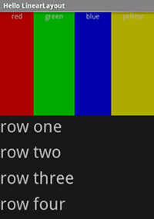
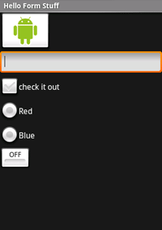
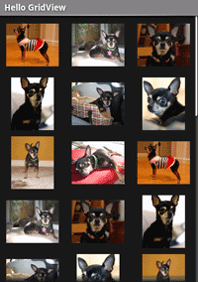
Views

Slide 34
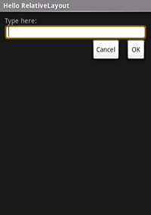
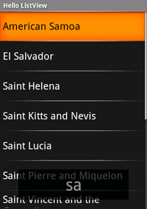
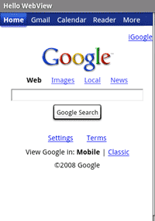
Views

Slide 35
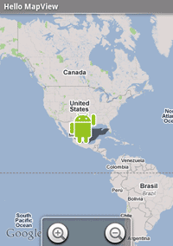
Location Manager

Slide 36
End of Lecture
First task, install the SDK and Eclipse for instructions detailed in Assignment #1
Will be performed in class as well.

